Slide 1
Digital Citizenship
Safely navigating the digital landscape

Slide 2
Agenda
How Predators Gain Entry
5 Good Digital Habits for Families
Video Game Safety
Tips and Tools for Online Safety
More Resources
github.com/davemehi/internet-safety

Slide 3

Technology and our daily lives

Slide 4
How Predators Gain Entry

Slide 5
How Predators Gain Entry
Social Engineering
Phishing
Smishing
Vishing
Sadfishing
Malware
Unsecure WIFI and Websites

Slide 6
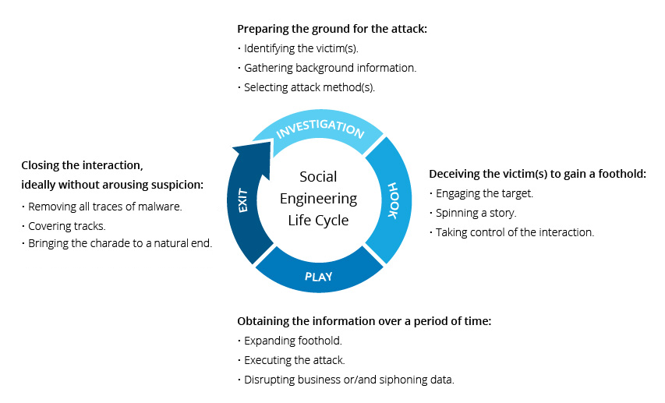
Predators: Social Engineering
A broad range of malicious activities using psychological manipulation to trick users into making security mistakes or giving away sensitive information.

Slide 7
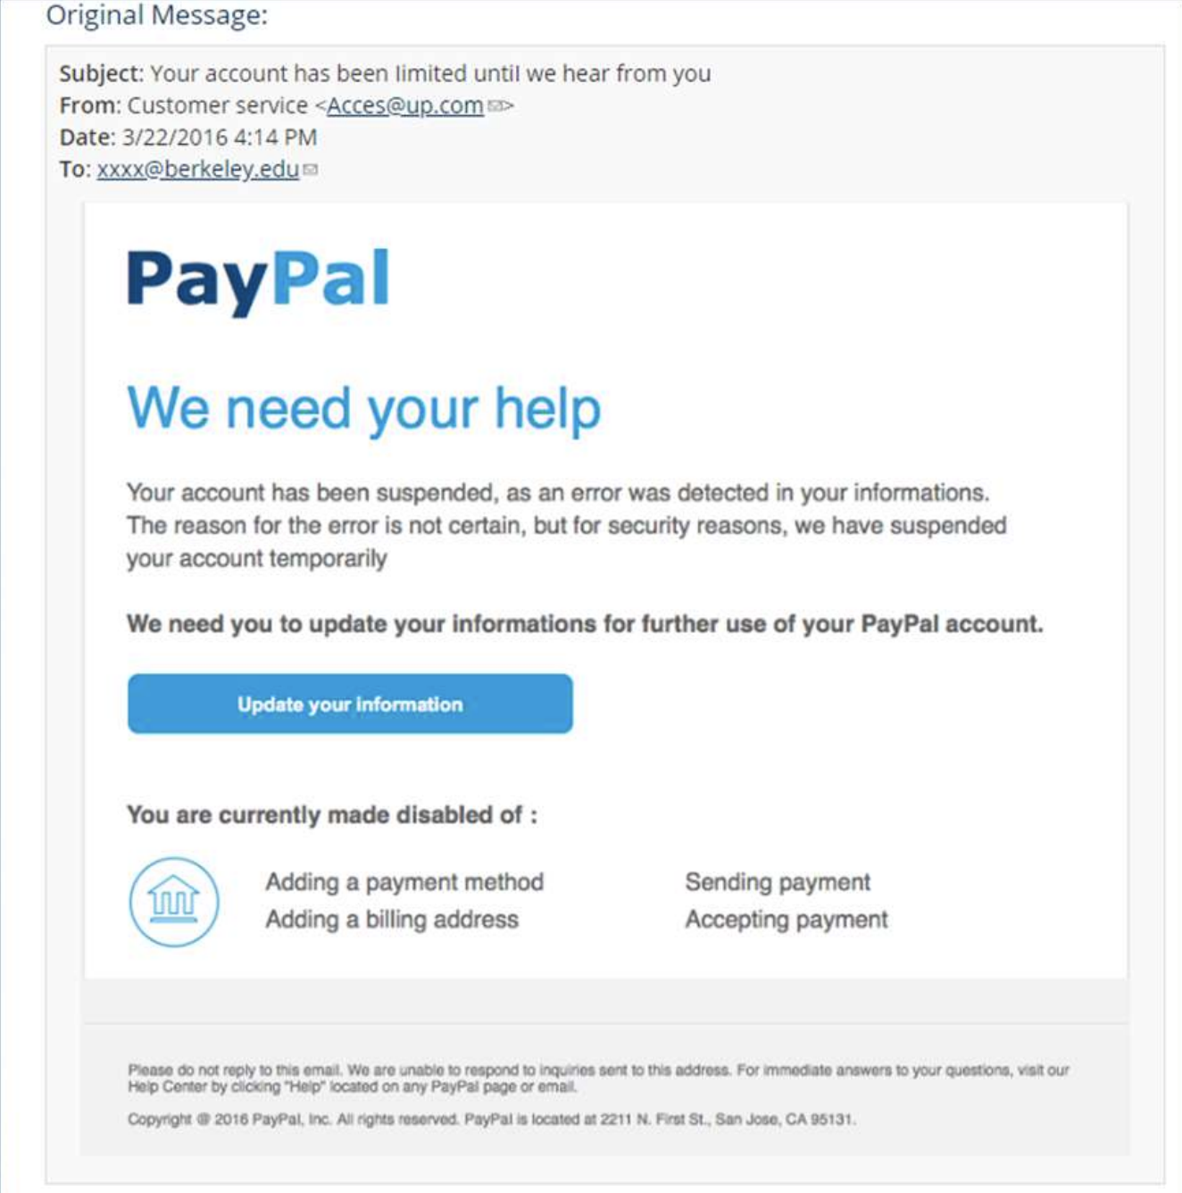
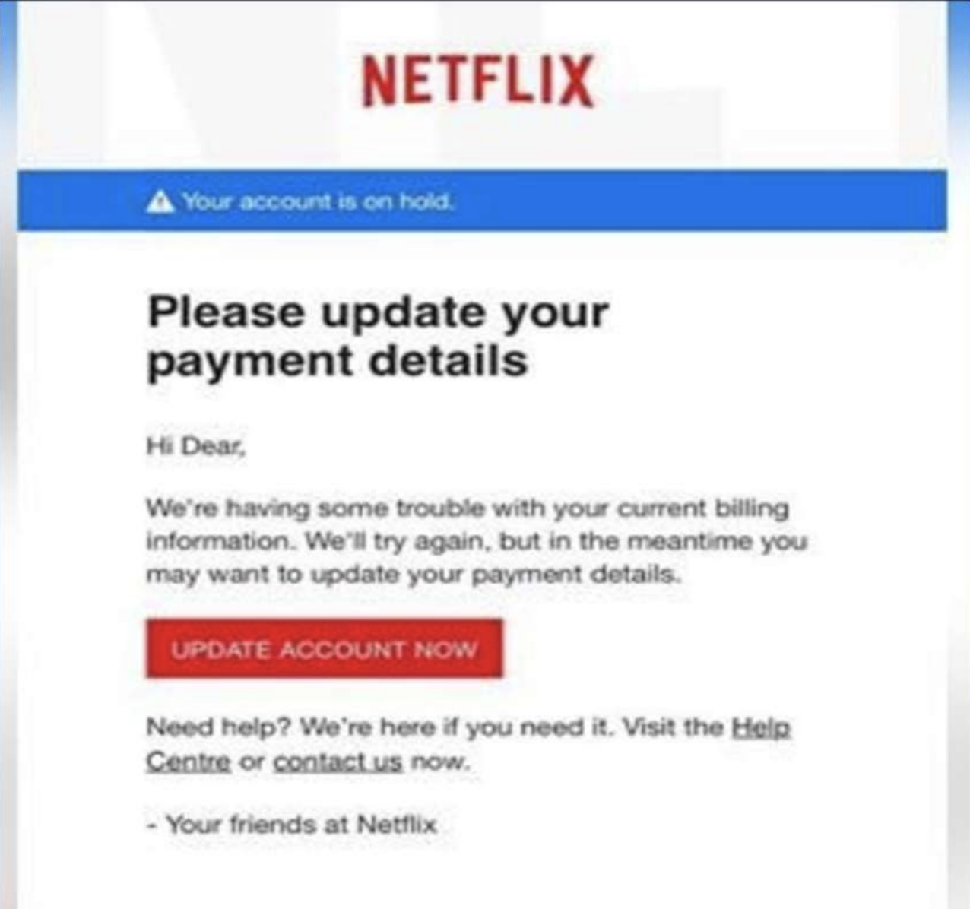
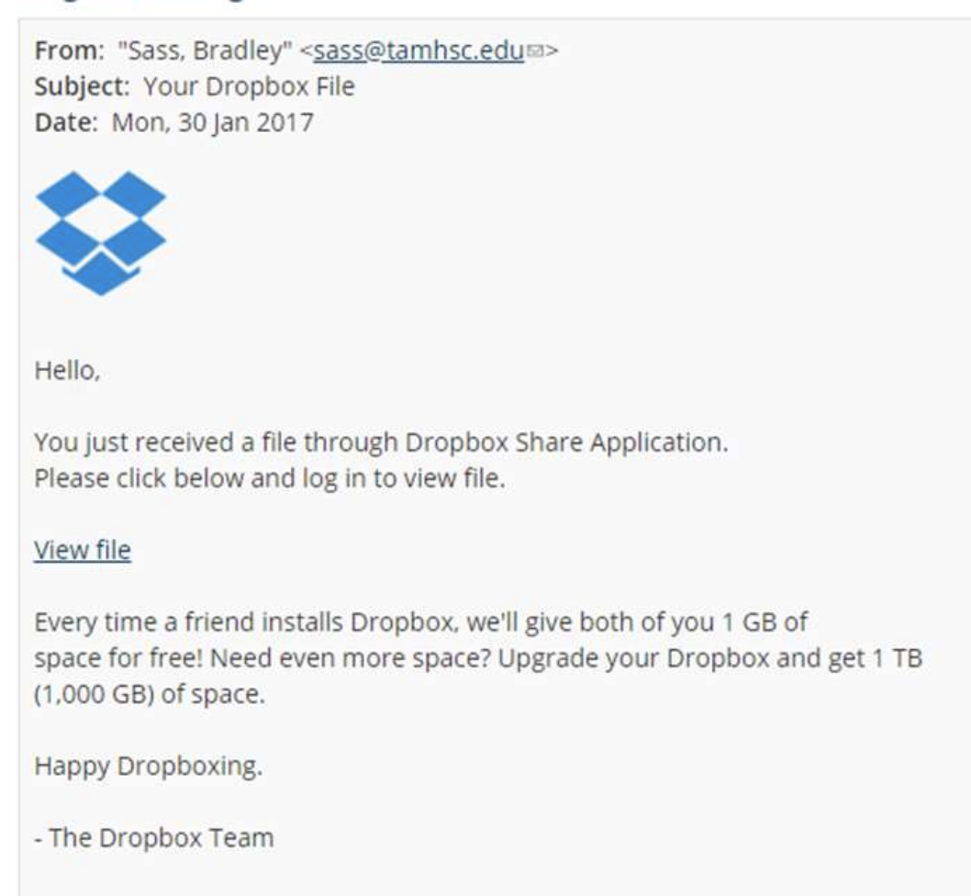
Predators: Phishing
Attacks typically involves cyber criminals impersonating a person or organization and using various tactics to extract information or compel the victim to perform a particular action.

Slide 8
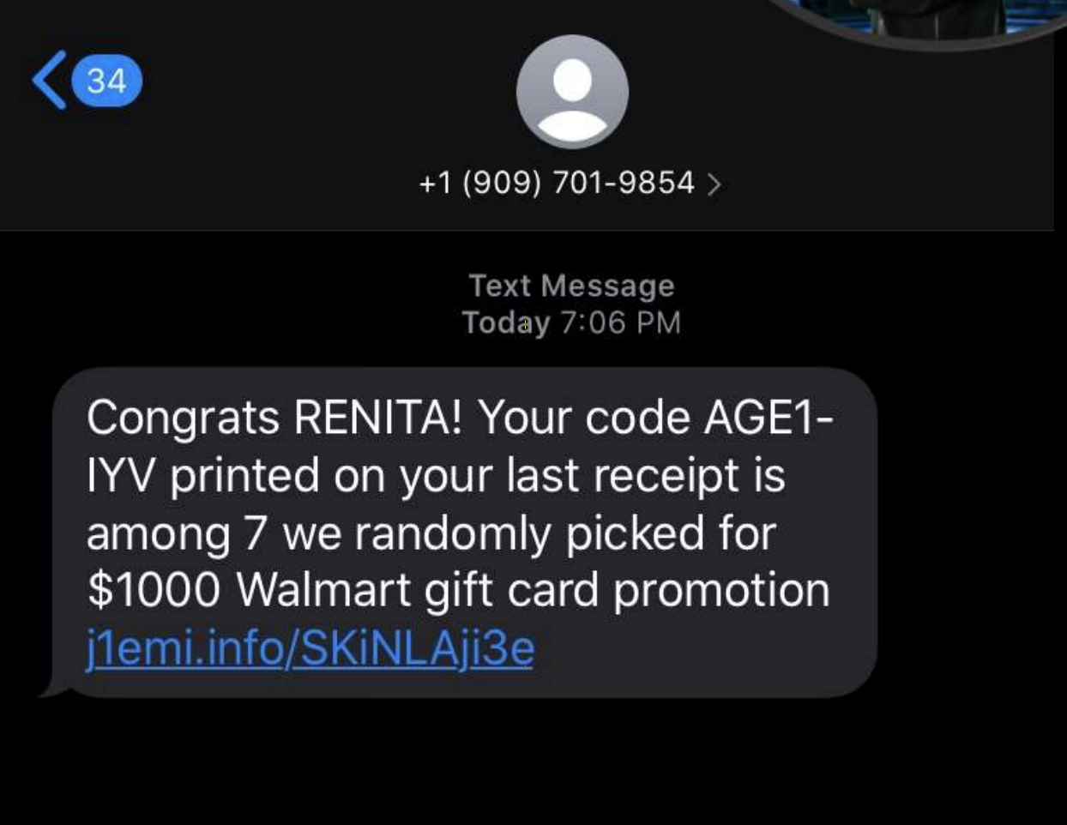
Predators: Smishing
Fraudulent practice of sending text messaging purporting to be from reputable companies in order to induce individuals to reveal personal information, such as passwords or credit card numbers.

Slide 9
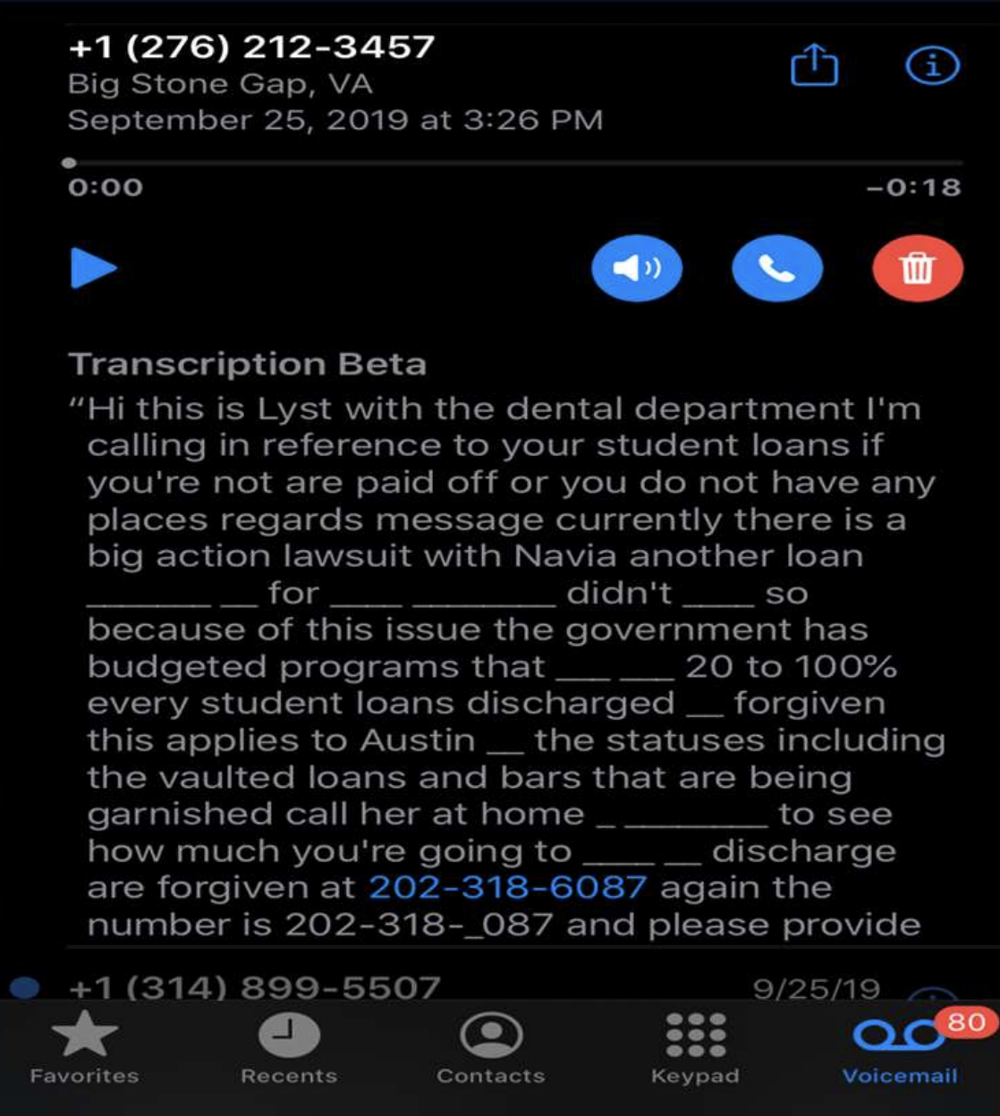
Predators: Vishing
A form of scam that aims to get prospective victims to share personal or financial information over the phone.

Slide 10

Predators: Sadfishing and Other Tactics
Sadfishing is a term used to describe the behaviour of someone making exaggerated claims about their emotional state to gain sympathy. Hackers can take advantage of this.
“I’m really in a bad spot right now … 😪😫 … I could really use some help 😓”
“Guess what! I got an A on my final exam! YES!!!! I’m so HAPPY!

Slide 11
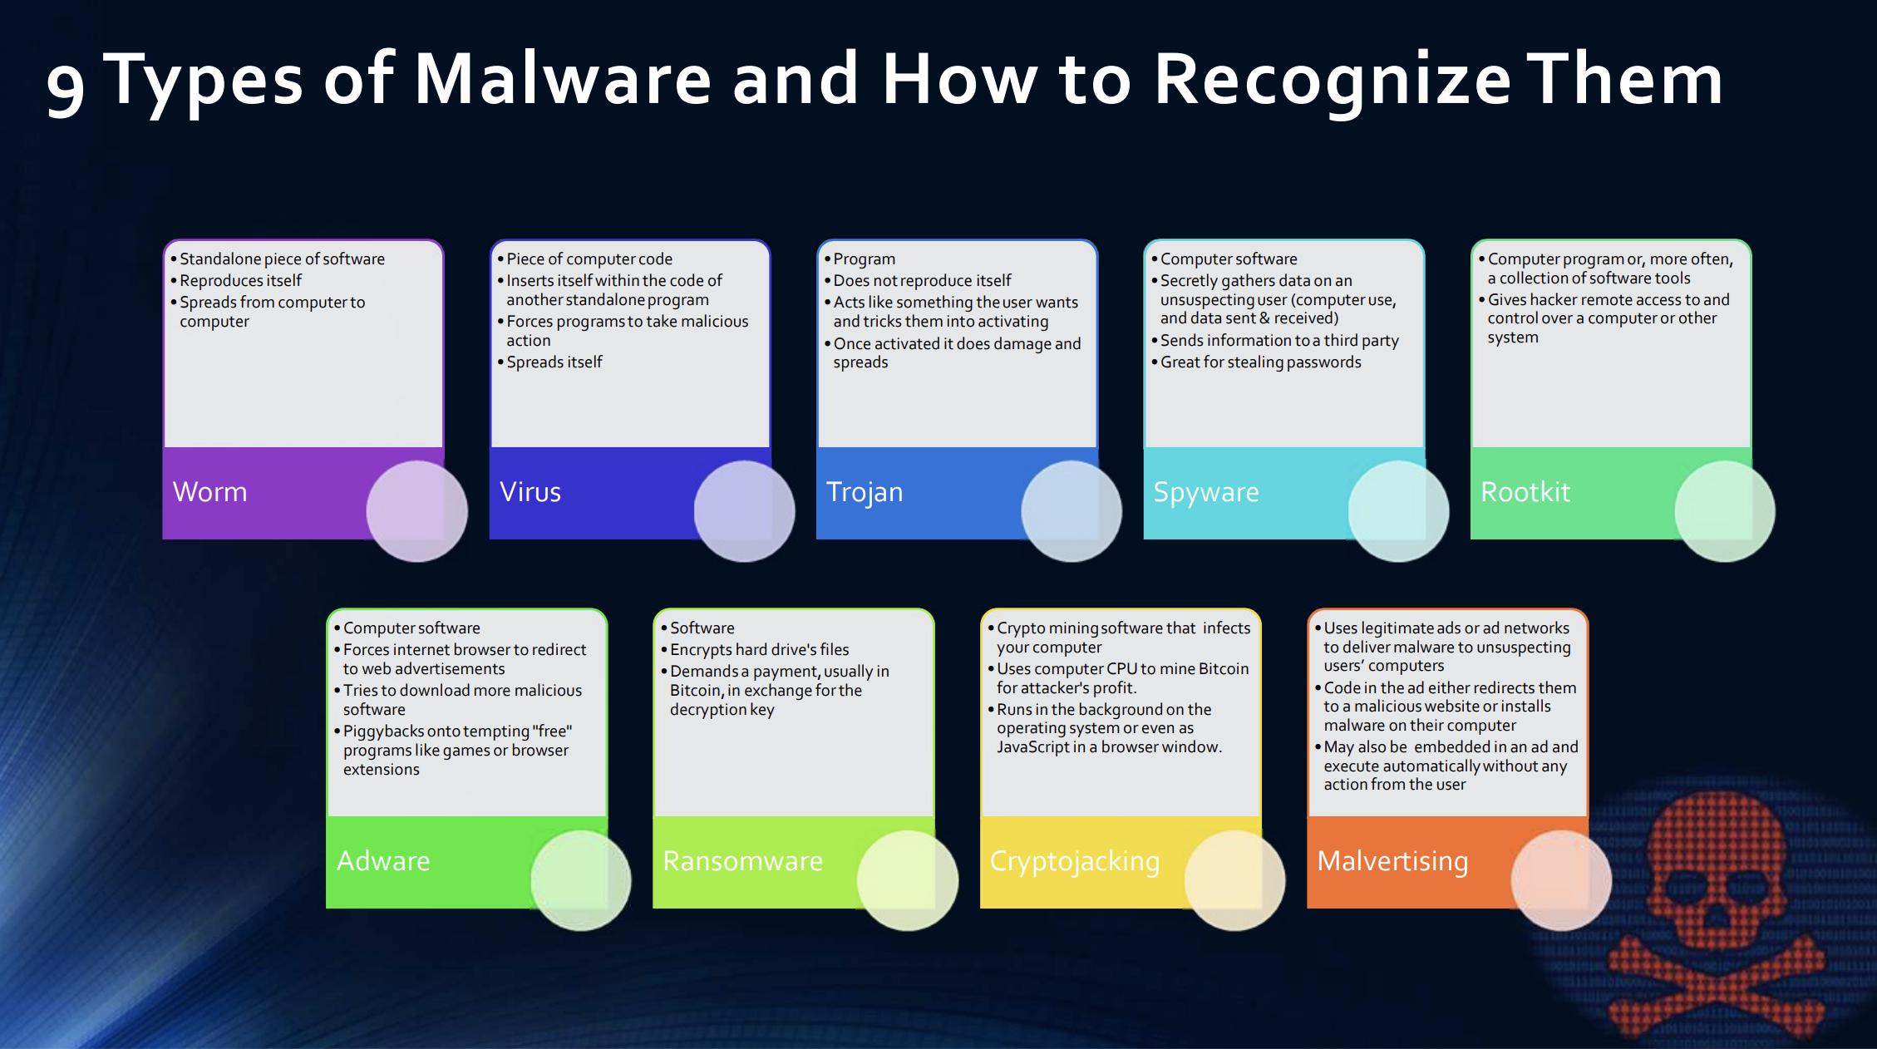
Predators: Malware
Software that is specifically designed to disrupt, damage or gain unauthorized access to a computer system.

Slide 12

Predators: Unsecure WIFI and Websites
Beware of Public WIFI - offered in many public places like coffee shops, libraries and airports.
Be very careful to use WIFI connections that do not use a password.
Look for https in the web address of every page they visit . (The “s” stands for secure. )
Look for the small lock icon next to the web address.
Always log out of your account or website
Be careful about letting your browser save your username and password
Free games, apps, music, and other downloads can hide malware.
Don’t download anything unless you trust the source.
Notes:
Public WIFI - offered in many public places like coffee shops, libraries and airports.
Tell your kids if they’re not asked for a password, they shouldn’t use that network to sign into accounts or send any personal information. And don’t assume that a Wi-Fi hotspot uses encryption: most of them don’t.
A secure site will encrypt your information while you are signed into it — even if the network doesn’t.
How will your kids know if a site is secure? Tell them to look for https in the web address of every page they visit — not just when they log in. The “s” stands for secure.
Recommend that your kids log out when they’ve finished using a site.
Free games, apps, music, and other downloads can hide malware.
Don’t download anything unless you trust the source.

Slide 13
5 Good Digital Habits for Families

Slide 14


https://beinternetawesome.withgoogle.com

Slide 15

5 Good Digital Habits for Families
Smart, Share with Care
Alert, Don’t Fall for Fake
Strong, Secure Your Secrets
Kind, Itʼs Cool to Be Kind
Brave, When in Doubt, Talk It Out
Be Internet Awesome!
https://beinternetawesome.withgoogle.com

Slide 16

Be a positive presence online, just like in real life
Think before you post. Ask yourself: Should I really post/share this??
Activity: Talk as a family about what is and is not allowed to be posted and shared
What can you share with family?
What can you shared with people outside the family?
Notes:
Information travels fast online, and without some careful consideration, we can find ourselves in situations that may have lasting consequences. The solution? Learning how and what to share with people we know and people we really don’t know.
Understanding what kinds of information are okay to be shared and what should be kept private — or just within your family.
Talking as a family about what your kids can do when they wonder what to share and who to share it with.
Learning how to see privacy from different perspectives.
Our online privacy depends a lot on what we do and don’t share about ourselves and our families online — especially on social media.
A really important skill for kids to have is knowing what is and isn’t okay to share. It’s a skill we all develop with practice, and the best place to start is at home.
Part of that skill-building is thinking about the two types of sharing that all families have: internal (what you share with family members only) and external (what you share with people outside the family).
Smart Activity
Your kids are really excited about a trip you’ve planned to visit their grandparents, and you are too. One of them used your smartphone to post about the trip on your social media profile — when you’re going and where, posting photos and “tagging” everyone, including the grandparents — in the post. Do you…
Tell them to delete the post because it’s unwise to post vacation dates and locations in social media because they’re basically “telling the world” that no one will be home during that time?
Ask them if they received permission from their grandparents if it's okay to post those photos and tag them in social media?
Remind them always to ask permission of anyone they photograph and talk about online before posting something about them?
Tell them they can always come and ask you if they’re not sure if it’s okay to share something online?
Tell them they should wait until after the trip is over to post online

Slide 17
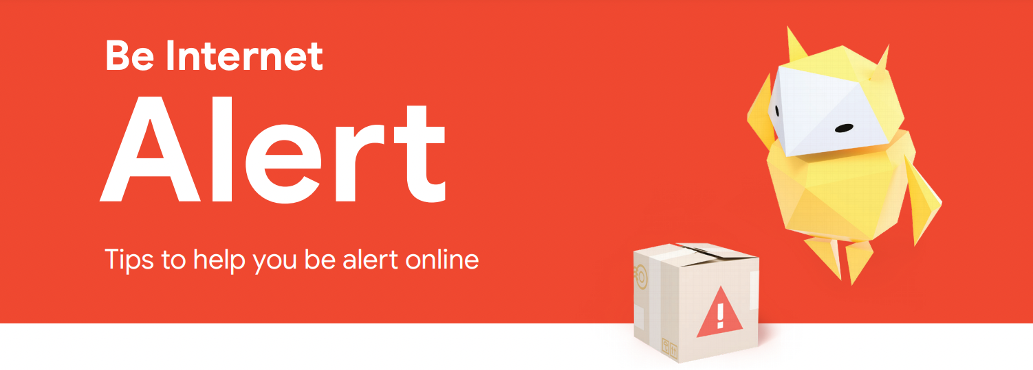
Figuring out what’s real and what’s fake is vital to online safety and citizenship.
Double check a site for safety and credibility.
Learn to differentiate between an advertisement and real content
Be aware of offers that sound too good to be true
Learn how to search and verify information before sharing
Activity: Talk about fake articles, do search exercises
Notes:
It’s important to help kids become aware that what they see online isn’t always true, real, or reliable.
Figuring out what’s real and what’s fake is vital to online safety and citizenship.
Understanding that just because something is online doesn’t mean it’s true.
Learning how online search works and why it’s important to use critical thinking when searching the Web for information and other content.
Thinking about the value of search results, websites, and other sources of information and be alert to misinformation, “fake news” and manipulation.
Alert Activity
Pick a topic your child is interested in (a pro athlete, their favorite cause, actor or musical artist, a much-loved film or author, etc.) and type it in the search box
Click on a variety of results, both from the results that appear at the top and from the ones that are found several pages deeper.
Ask how they feel about results that come from results near the top vs. results they find deeper in. Do they trust one more than another? Why or why not?

Slide 18
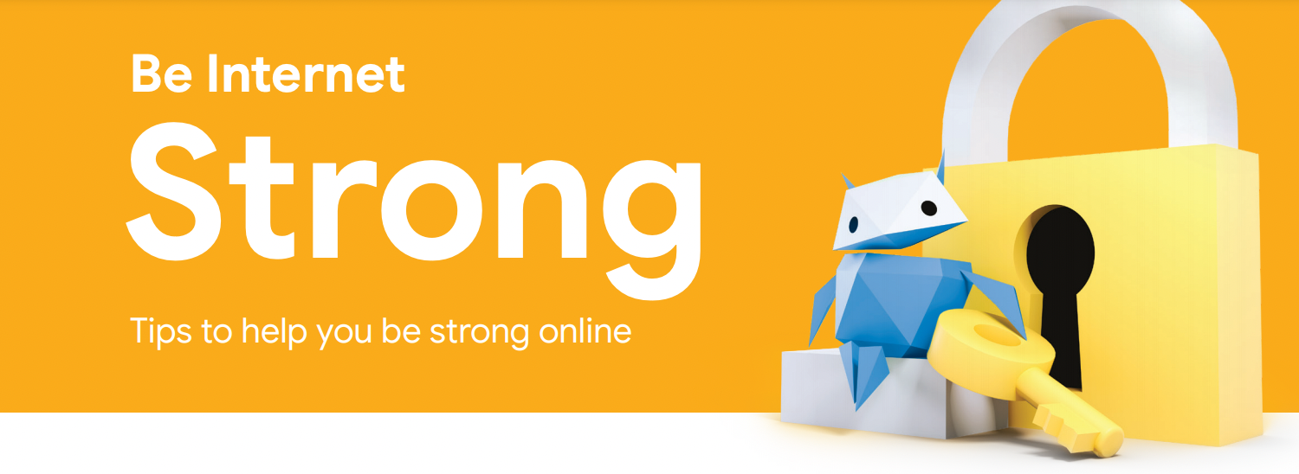
Avoid sharing personal information online (SSN, addresses, birthdates, Maiden names, etc)
Create a screenname that does not include personal information
jessicaparra2005
pumpkinpie123
Create strong passwords. Do not re-use passwords on multiple accounts
Notes:
The security of your information, accounts, and devices is just as important as your privacy.
Strong passwords and the commitment not to share them are vital to protecting your family’s devices, identities, reputations, and relationships.
Screen names
jessicaparra2005
pumpkinpie123
Did you know that in 2017, the top two passwords people used were “123456” and “password”? Passwords protect our personal safety, devices, identities, reputations, and relationships, and weak ones make it easy for criminals to get our information.
One of the most fundamental things we can teach our kids is how to create strong passwords.
Don’t use the same password on multiple accounts

Slide 19
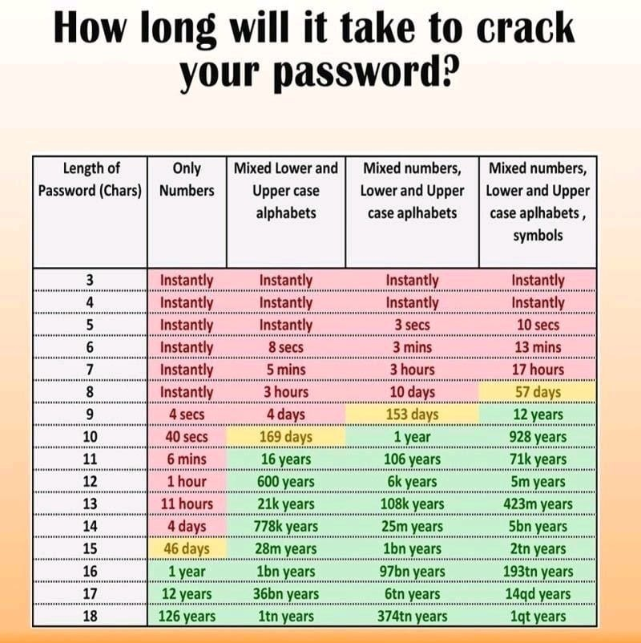
Activity: Sit down as a family and create a good set of screen names and strong passwords for practice.
Passwords:
Has 10 characters or more
Includes numbers, upper case, lower case and symbols
Use memorable phrases mixed with numbers and symbols
Notes:
The security of your information, accounts, and devices is just as important as your privacy.
Strong passwords and the commitment not to share them are vital to protecting your family’s devices, identities, reputations, and relationships.
Screen names
jessicaparra2005
pumpkinpie123
Did you know that in 2017, the top two passwords people used were “123456” and “password”? Passwords protect our personal safety, devices, identities, reputations, and relationships, and weak ones make it easy for criminals to get our information.
One of the most fundamental things we can teach our kids is how to create strong passwords.
Don’t use the same password on multiple accounts

Slide 20
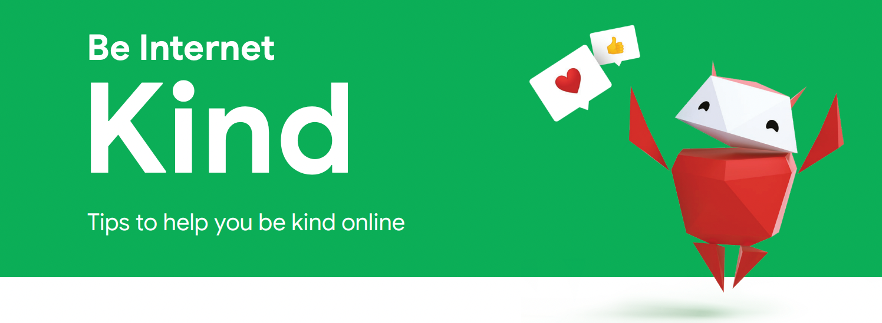
Treat others how you want to be treated, both online and in real life.
Define what positive behavior means in your family.
Activity: Have a discussion on what kinds of actions and behavior are important.
Think about what that looks like digitally: texts, posts, comments, photos, and videos.
Notes:
The Internet is a remarkable communication tool, and you need look no further than…well, the Internet, to see that it can be (and is) used to spread inspiring and uplifting information, or shocking and hateful commentary and opinions.
Unfortunately, the Internet itself makes no distinction between kindness or cruelty. That’s where you come in. Families are powerful influencers of their children, and they can help them “take the high road” by exemplifying the concept of “treating others as you’d want to be treated”, supporting their friends, and defusing drama and cyberbullying.
Defining what positive behavior means in your family.
Understanding what positivity looks like and how to express it online and through devices.
Identifying situations where it’s better to wait to communicate face-to-face than to text or post online — and when to ask a parent or older sibling for help.
If you haven’t already, have a discussion on what kinds of actions and behavior are important — talk about how your family treats people.
Think about what that looks like digitally: texts, posts, comments, photos, and videos.
Be Kind Activity
Get two or more of the phones in your family and open up your text messages (or a messaging app everybody uses), and start a conversation between two family members. It could be about a real or made up situation — something you’re going to do this weekend, something that happened at school, someone who asked for a family member’s help, etc.
Read the conversation out loud in a specific tone of voice — happy, sad, angry, etc.
Talk about what you noticed while listening to them read. How did you feel when you heard it? What do you think someone outside your family would think or feel? How could those texts been worded differently? You’ll probably come up with other questions, so have at it. :)
Next, have two different family members try having a text conversation with a different tone from the first one: maybe an angry or sad one. Read that out loud and talk about how it came across to everybody while listening to it.

Slide 21
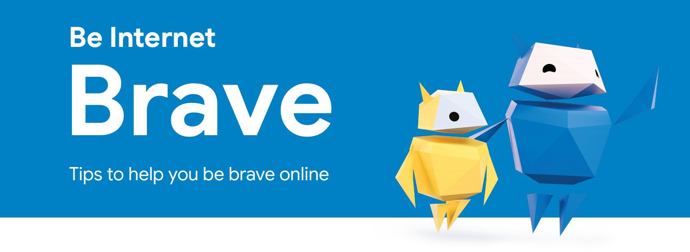
Found something negative? Say something!
It takes courage and bravery to speak up
Report and/or block inappropriate content
It’s important for kids to understand that they’re not on their own
Discuss family attitudes and policies about what is and isn’t acceptable usage of devices and media, and when.
Activity: Discuss online situations and how they should be handled
Notes:
It’s important for kids to understand that they’re not on their own when they see inappropriate content or behavior online that makes them feel uncomfortable — especially if it’s hurtful to them or someone they care about.
They should never hesitate to get help from you or another family member they trust. It’s also good for them to know there are different ways to be brave and take action, including talking things out offline and using online reporting tools.
Define your values with your family. One way to do it could look like this: “In our family, we treat people with _________________ both online and offline”
Keep communication lines open and firmly establish home as a safe place to talk about what happens at school and online.
Communicate frequently about family policies or rules about the value and priority of different kinds of technology use — for communication, entertainment, work, play, socializing, etc.
Discuss family attitudes and policies about what is and isn’t acceptable usage of devices and media, and when.
Brave Activity
One of you is playing an online game with friends and someone none of the players know starts chatting with them. They’re not being mean, just nobody knows them. Decide what to do.
Report them?
Talk with another family member?
Ask them to leave
Ask them to stop chatting with you

Slide 22
Video Game Safety

Slide 23

Video Games Then vs Now

Slide 24


Video Games Now
Games today are …
Online and integrated with the internet
Designed to be social, multi-player
Trendy and incorporate popular music, movie characters and celebrities
Epic Adventures in new virtual worlds
Creative gameplay
Notes:
https://www.marketwatch.com/story/videogames-are-a-bigger-industry-than-sports-and-movies-combined-thanks-to-the-pandemic-11608654990
https://www.statista.com/statistics/746230/fortnite-players/

Slide 25
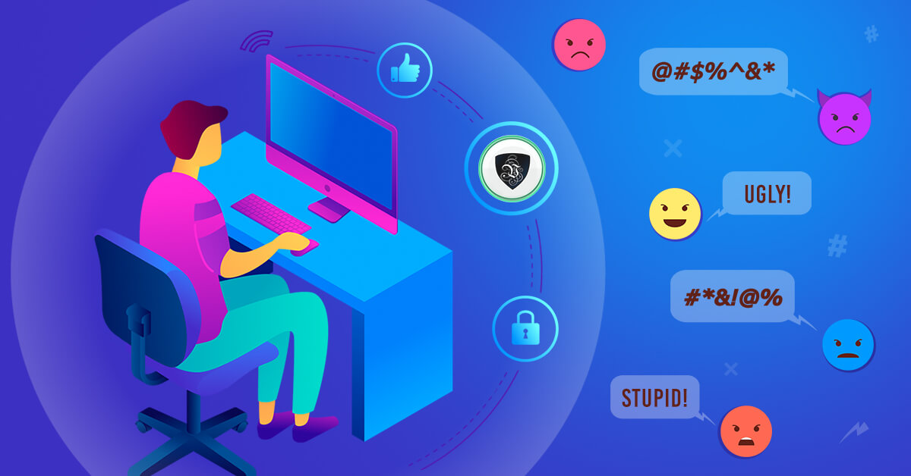
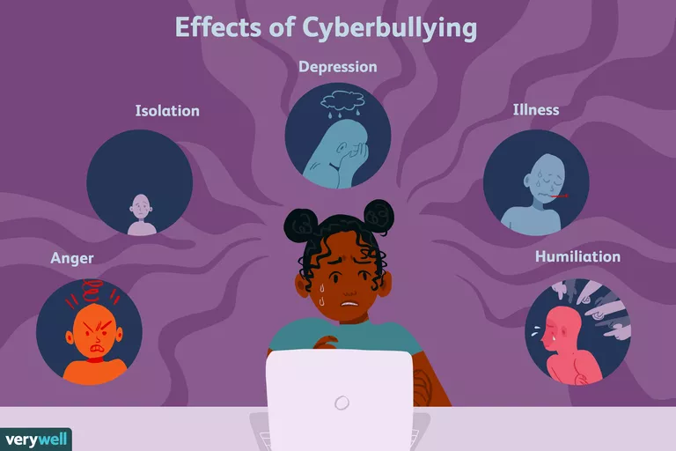
Video Game Risks
Cyberbullying
Griefing - Making the game less enjoyable
Kill stealing - Stealing targets, coordinated efforts against players
Whispering - Bad-mouthing players in chat
Doxxing
Privacy
Screen names
Delete info before disposing or selling
Personal Information
Webcam worries
Notes:
https://usa.kaspersky.com/resource-center/threats/top-7-online-gaming-dangers-facing-kids
https://us.norton.com/internetsecurity-kids-safety-video-game-security-how-to-stay-safer-while-gaming.html

Slide 26


Video Game Risks
Malware
Downloading unknown games from unknown sites is a risk
Check recent reviews, cyber-security programs, research
Beware “cracked” games or “cheats”
Consider keeping the gaming computer for gaming purposes only
Install cyber-security software
Notes:
https://usa.kaspersky.com/resource-center/threats/top-7-online-gaming-dangers-facing-kids

Slide 27
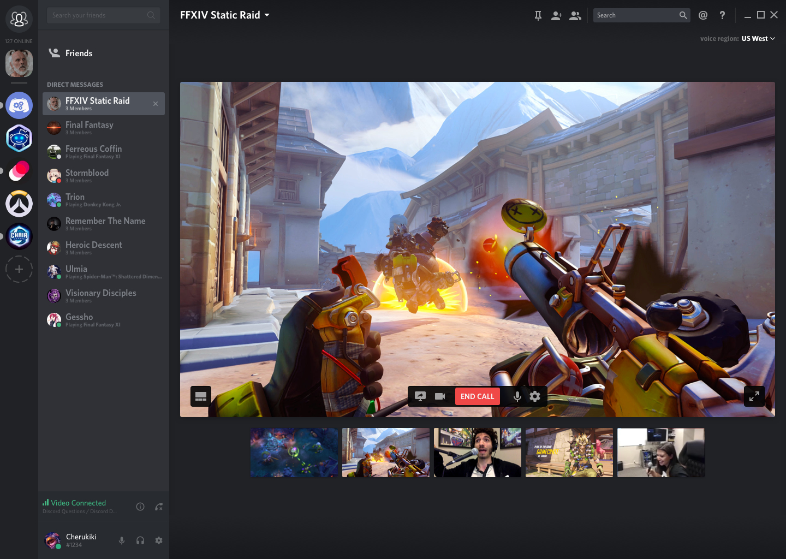
Video Game Risks
Online chat
Giving away personal information
Engaging with strangers
Online predators
Shared experiences
Build relationships through “understanding”
Squads
Racist language
Sexist language
Notes:
https://usa.kaspersky.com/resource-center/threats/top-7-online-gaming-dangers-facing-kids

Slide 28
Video Games Financial Risks
Due to the pandemic, the Video Game Industry is bigger than the movie and sports industry combined! $180 billion in sales in 2020!
The eSports is growing very fast. Total esports viewership is over 500 million people.
eSports on track to earn over $1 billion
Many games offer ‘In-game” or “in-app” purchases (Freemium)
Expanded functionality, virtual currencies, weaponry, special abilities and even new dance moves!
Beware giving out credit card and saving it in the game
For Apple/Google stores, use password confirmation on purchase
Be aware of purchasing in-game items or game help from people online
Notes:
https://www.getsafeonline.org/protecting-yourself/online-gaming/
https://www.internetmatters.org/resources/online-gaming-advice/online-gaming-the-risks/

Slide 29
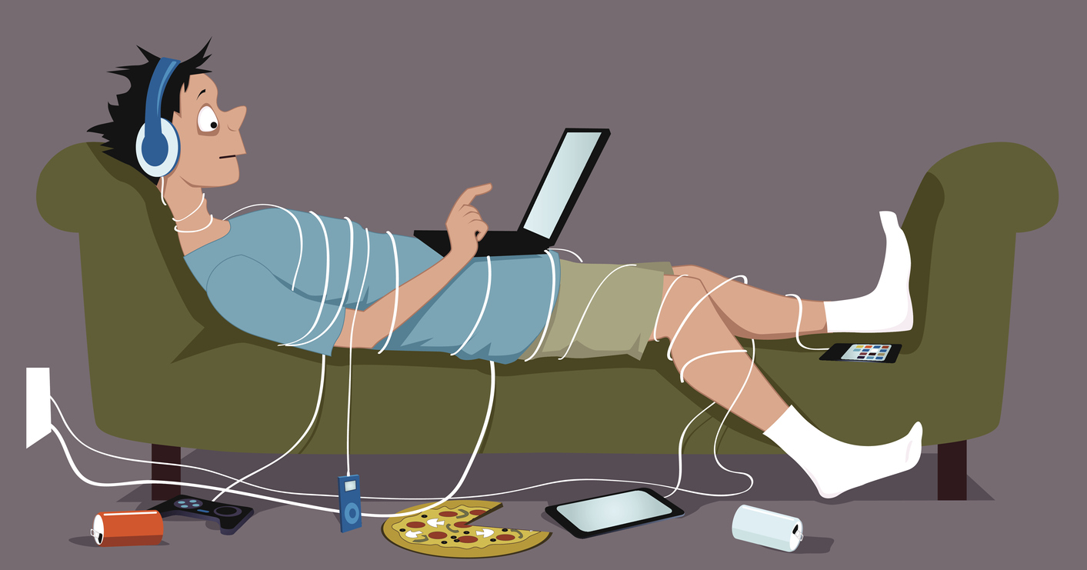

Video Games Health Risks
Gaming Addiction
Mainly sedentary - encourage movement and motion
Take breaks and move around
Dealing with stress and anger
Effects of Cyberbullying
Depression and Anxiety
Sleep disturbances
Academic decline
Notes:
https://www.getsafeonline.org/protecting-yourself/online-gaming/
https://www.internetmatters.org/resources/online-gaming-advice/online-gaming-the-risks/
https://www.internetmatters.org/resources/gaming-guide-for-teens/
https://www.internetmatters.org/resources/gaming-guide-for-pre-teens/
https://www.verywellfamily.com/what-are-the-effects-of-cyberbullying-460558

Slide 30
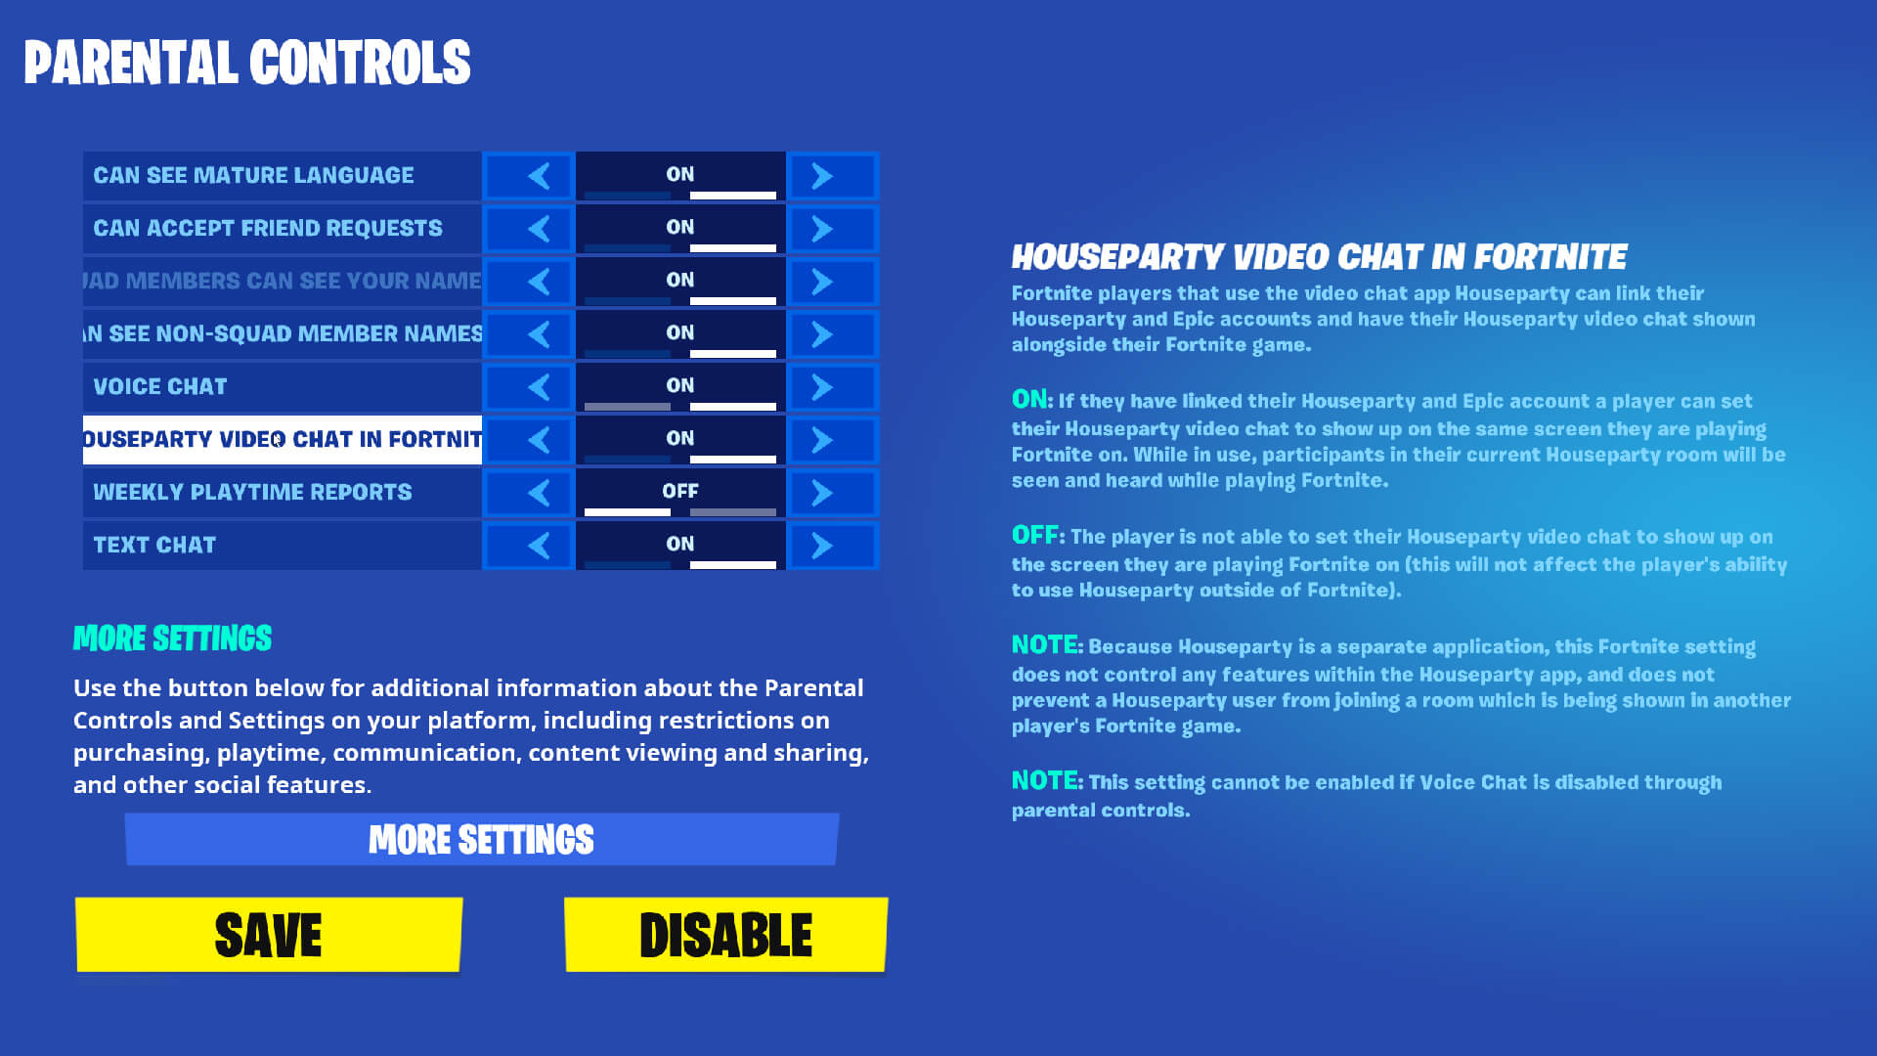
Video Games Security Settings
Most games have privacy settings and parental controls - find them and configure them
Disable chat
Disable webcam
Review game ratings
Be careful of credit card information
Find parental guides to many games/apps here: https://nationalonlinesafety.com/
Notes:
https://www.getsafeonline.org/protecting-yourself/online-gaming/
https://www.internetmatters.org/resources/online-gaming-advice/online-gaming-the-risks/

Slide 31
Tips and Tools For Online Safety

Slide 32
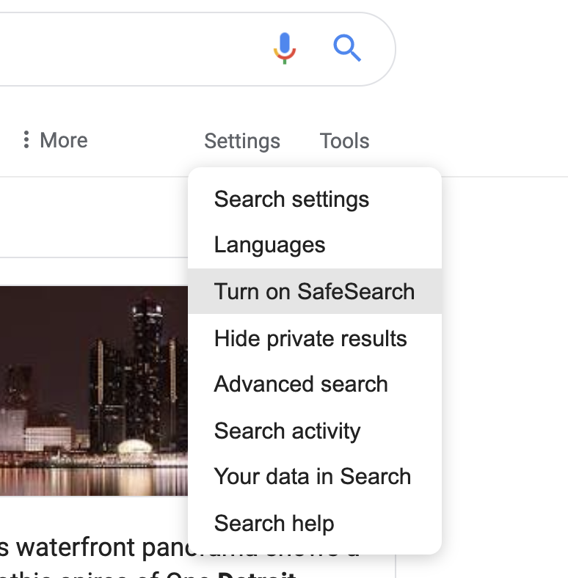
Google Safe Search Settings
Turn on safe search for your account
When SafeSearch is on, it helps filter out explicit content in Google's search results
While SafeSearch isn’t 100% accurate, it’s designed to help block explicit results, like pornography
SafeSearch turned on automatically for users under 13
Notes:
Turn on safe search for your account
When SafeSearch is on, it helps filter out explicit content in Google's search results for all your queries across images, videos, and websites.
While SafeSearch isn’t 100% accurate, it’s designed to help block explicit results, like pornography, from your Google search results.
SafeSearch turned on automatically for users under 13

Slide 33
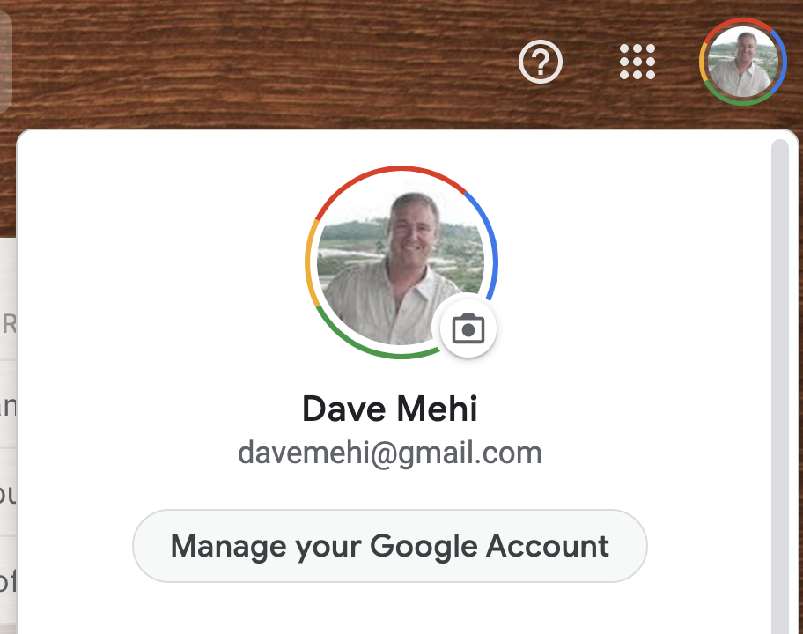
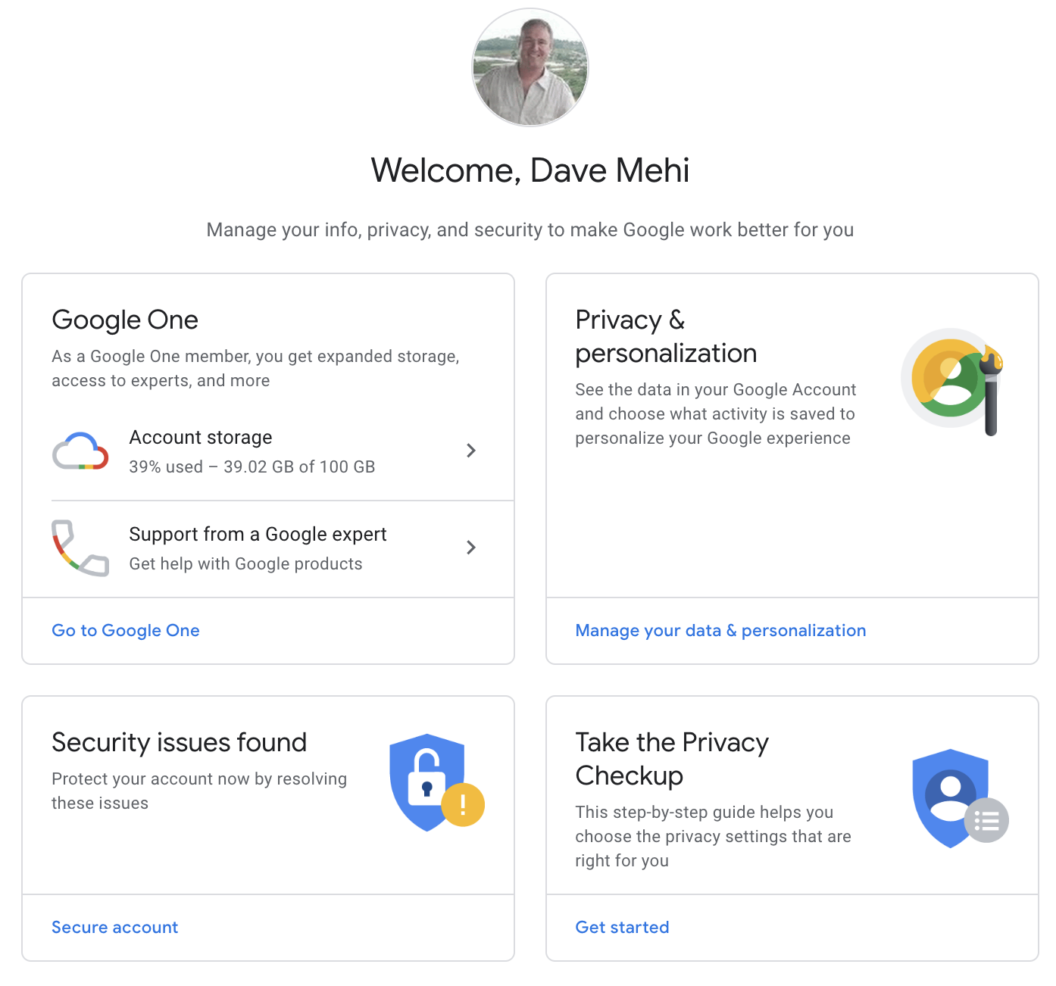
Google Account Privacy Settings
Click upper right photo of yourself (need to be logged in)
Click “Manage Your Google Account”
Click “Privacy & Personalization” to see the data and activity that is saved.
Click “Take the Privacy Checkup” to see your privacy settings.

Slide 34
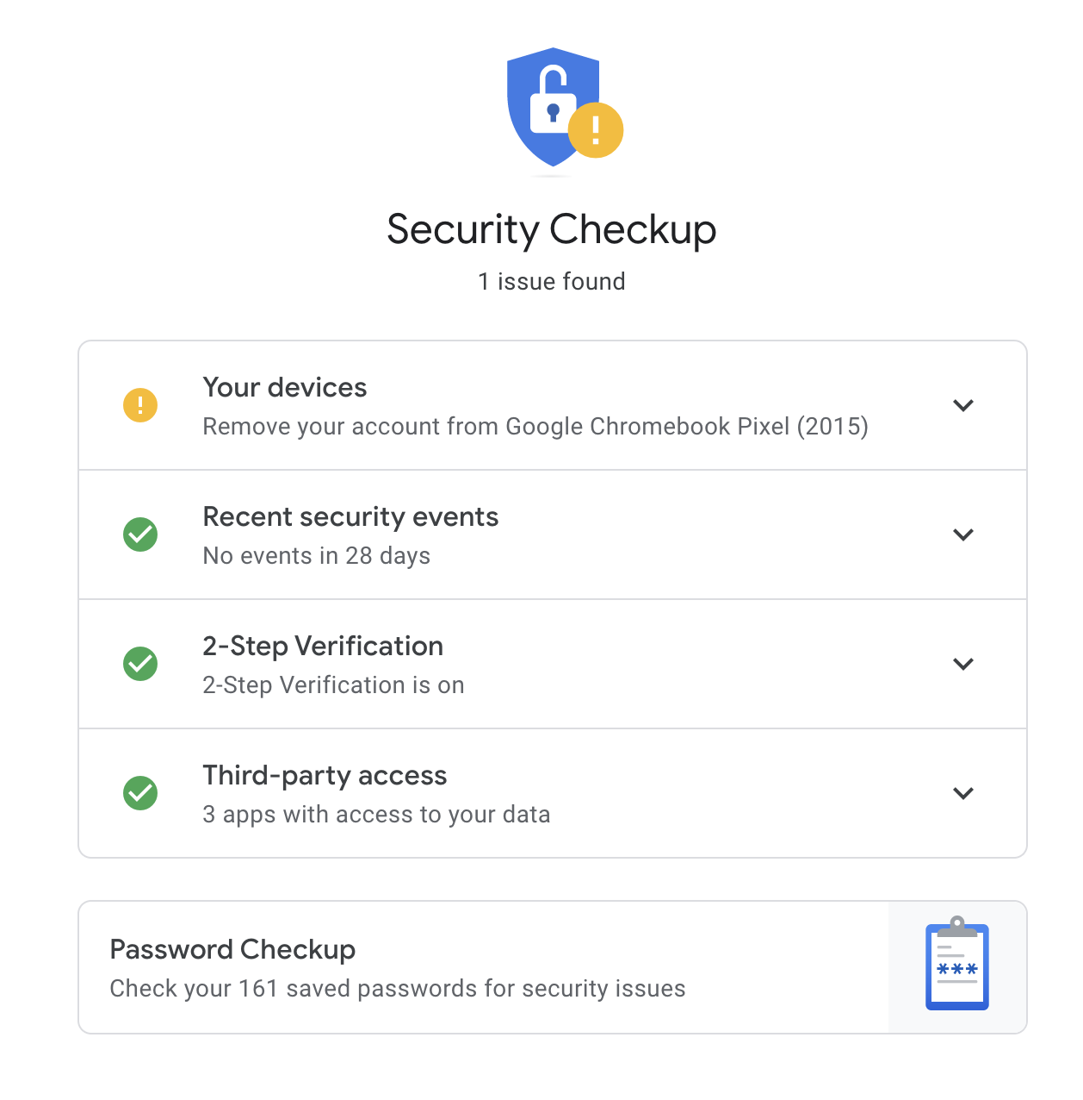
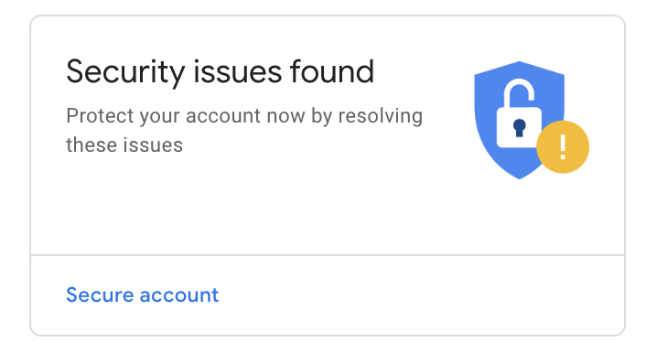
Google Security Checkup
Tool to check security of your Google account
https://myaccount.google.com/security-checkup

Slide 35
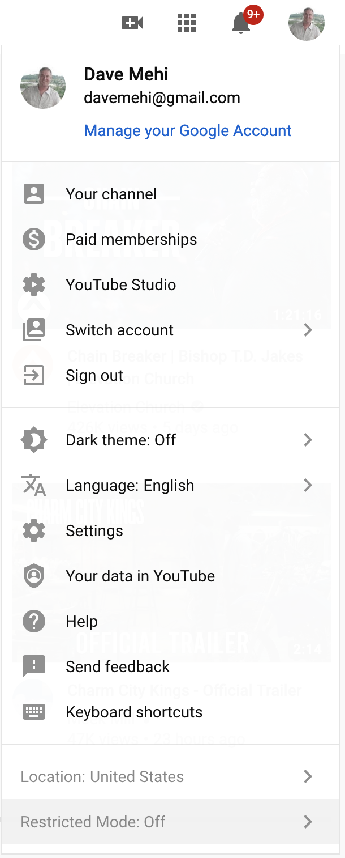
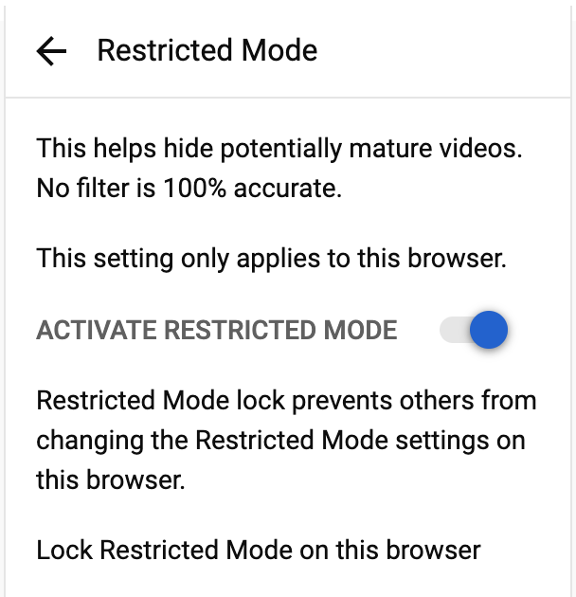
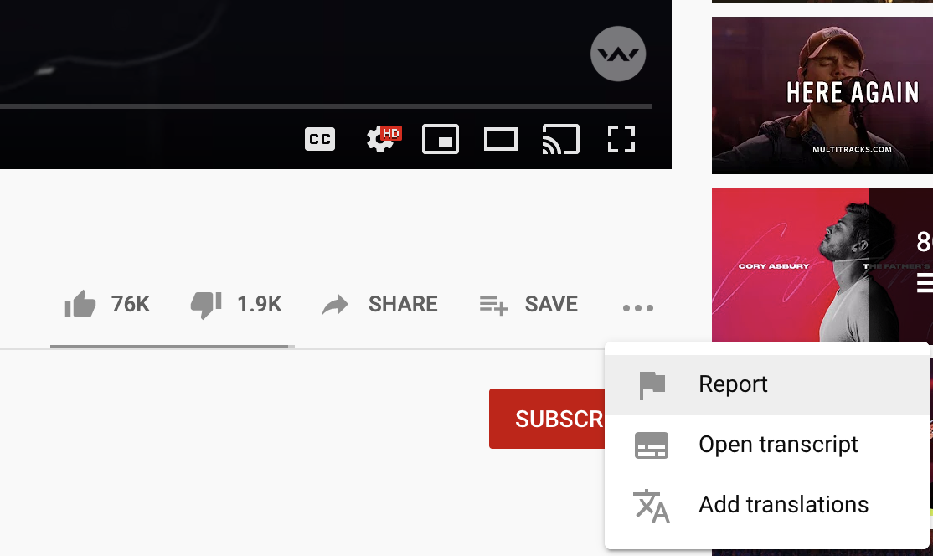
Youtube Settings
Restricted Mode (Safe Mode) is an optional setting that screens out potentially mature content
Click Account Photo at the top right
At the bottom, click “Restricted Mode”
Click “Activate Restricted Mode”
Report content as inappropriate

Slide 36
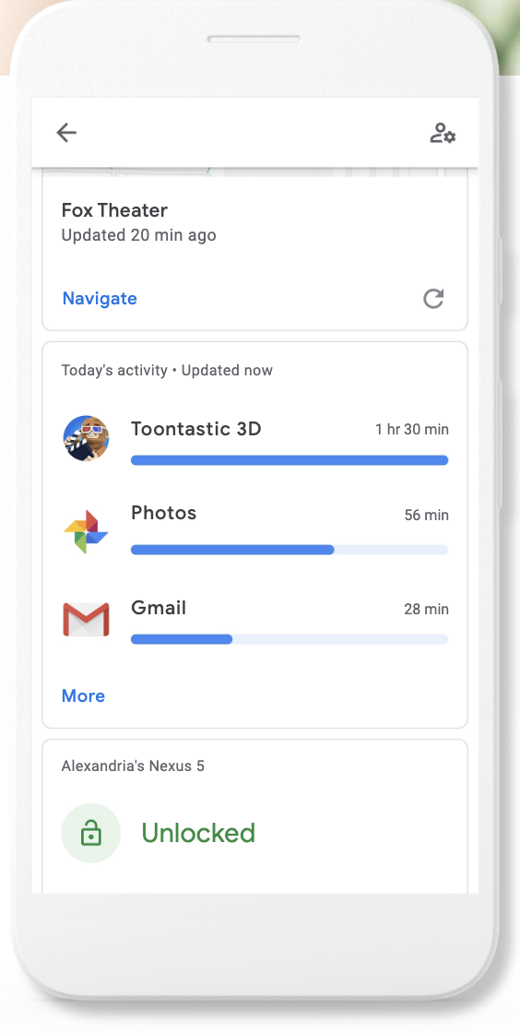
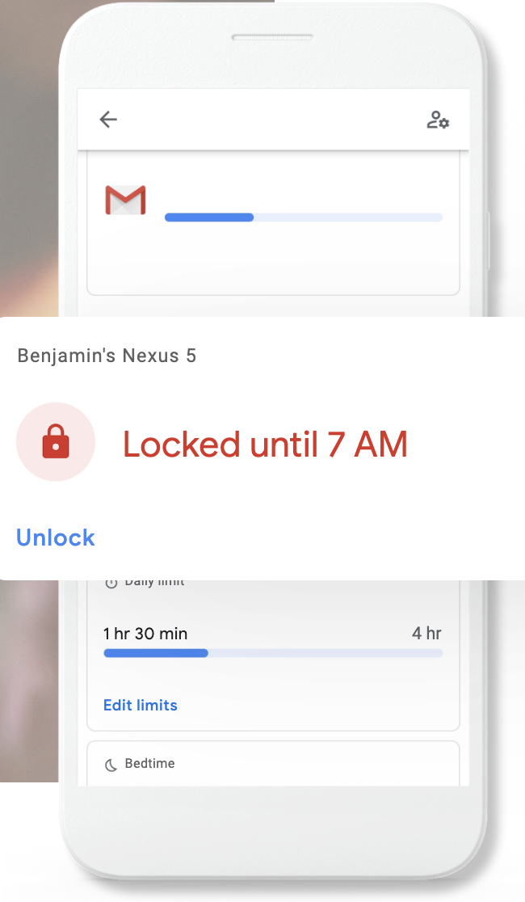
Family Link / Qustodio
Family Link is an app by Google that will help set digital ground rules
Keeps an eye on screen time
Remotely lock devices
See where they are (geolocation)
App download warnings and approvals
Available for both Android and iPhone
https://families.google.com/familylink/
Qustodio is an alternative free software to monitor your children’s device usage

Slide 37


Security Setup: Home Routers / VPN
Recommended
Approach
Internet
Default
(4) Additional Parental Controls
Internet
VPN Server
ATT U-Verse
Xfinity
(Limited Parental Controls available)
Wireless Router
(3) Parental Controls available
Wireless Router
Additional Router
(1) Security Software installed on devices
(2) Configure game/app security settings
Notes:
CleanBrowsing DNS
https://www.highspeedinternet.com/resources/best-routers-for-security
Router: Netgear Nighthawk

Slide 38
No Silver Bullet - Use a Layered Approach for Security
Use software like FamilyLink or Qustodio that is installed directly on the phone or device.
Use parental controls on the home WIFI router. If your provider does not have one, you can buy another wireless router that does
Use a VPN that filters content
Use random checks
No private use of devices in the bedroom
Seek out game or app specific security settings
It is complicated, but it’s too important not to spend time to figure it out.

Slide 39
Privacy Tips
When you're on a website, try to remain as anonymous as possible. That means keeping all private information private. Private information that you should never allow the public to see includes:
Your full name
Location sharing
Any type of photograph (even of your pet!)
Your current location (some phones have automatic GPS apps built in that may need to be turned off)
Home or school address or the address of any of your family or friends
Phone numbers
Social Security number
Passwords
Names of family members
Credit card numbers

Slide 40
Additional Security Tips and Tools
Apple/Android - Password check when downloading apps
2-Factor Authentication (2FA)
Cover for the webcam (laptops)
How to remove personal information from Google
https://support.google.com/websearch/troubleshooter/3111061#ts=2889054,2889099
Phone
Location sharing
Popular apps and sharing data
Virus, safety software
Lifelock - Identity Theft
Emails
Don’t open from those that you don’t know
Use Gmail, or other reputable email provider

Slide 41
Additional Resources

Slide 42
Other Apps to Be Aware Of
Snapchat
Messages disappear, Location tracking on by default
Tik Tok and similar apps
Chat-based apps
Chatspin, Chat Master, Among Us, Kik
Social Media
Facebook, Instagram, Ask.fm
Twitch and other live broadcasting apps
Use the security setting to need approval to install an app.
There are too many apps to list and new ones are being created all the time
Must keep on top of the latest
Notes:
https://www.familyeducation.com/mobile-apps/a-complete-guide-to-potentially-dangerous-apps-all-parents-should-be-aware-of

Slide 43
Tips for Parents
Stay involved, Learn, Join In | Keep their information private | Stay safe on the move
Keep talking and stay interested in what they’re doing. Don’t be afraid to bring up challenging issues like sexting, pornography and cyberbullying. It could be embarrassing, but you’ll both benefit from the subjects being out in the open. | Your child can set privacy settings on most social networking sites so that only close friends can search for them, tag them in a photograph or share what they’ve posted. | Use safe settings on all mobile devices but be aware that if your child is accessing the internet using public WiFi, filters to block inappropriate content may not be active.

Slide 44
Tips for Parents
Be responsible | Talk about online reputation | Show you trust them
Talk to your teenager about being responsible when they’re online. Children often feel they can say things online that they wouldn’t say face-to-face. Teach them to always have respect for themselves and others online. | Let them know that anything they upload, email or message could stay around forever online. Remind them they should only do things online that they wouldn’t mind you, their teacher or a future employer seeing. Get them to think about creating a positive digital footprint. | If you can afford to, give them a small allowance that they can use for spending online so they can download apps, music and films for themselves, from places you agree together.

Slide 45
Real Parent Stories
A teenage girl (15) sent my son’s cousin (16) a very inappropriate video. He sent it to my son (13) and other kids. My son deleted the video but didn’t tell me at first. Soon the video went viral in the school. The girl’s parents found out and called the police. The detective said he has a huge pile of similar cases on his desk and can’t get to them all. The son was cleared but his cousin may get in real trouble for distributing child pornography.
My 12yo daughter was getting a few messages from guys in their 20’s on snapchat. These were friends of friends. One kept bugging her for the Netflix/Amazon passwords. Others asked borderline questions like what time does she go to bed and when does she go to the library. She didn’t respond and we blocked them. We have had lots of talks about social media safety
Lots of periodic checks on their phones. We have a no-shaming policy at our house. No screen time and everything is off by 8pm. 2 hour time limit. The rule is we can check at any time and we always have their passwords. But most important is real discussion about the impact of social media. We really talk with them about when it can be harmful, what should set off a red flag, what you should never do since you can’t take it back, and respect of yourself and others.
This is difficult with ever-changing new apps and trends. We do random phone checks regularly. We didn’t know Snapchat had a location tracking feature until one of our boys was being followed by a young girl!

Slide 46
“At the end of the day, no law or regulation can take the place of parental engagement and guidance. Companies, parents, teachers, civil society groups and policymakers must work together in a cooperative and collaborative way to address specific challenges that minors face online and to promote best practices for online safety.“

Slide 47
Important Resources
https://beinternetawesome.withgoogle.com/en_us/
https://safety.google/
https://www.internetmatters.org/advice/14plus/
https://www.internetmatters.org/resources/monitoring-apps-parents-guide/
https://nationalonlinesafety.com/ - Features guides to many popular apps/games
https://nationalonlinesafety.com/training
https://smartsocial.com/app-guide-parents-teachers/
Notes:
https://www.internetmatters.org/resources/gaming-guide-for-teens/
https://www.internetmatters.org/resources/gaming-guide-for-pre-teens/
https://www.childline.org.uk/info-advice/bullying-abuse-safety/online-mobile-safety/sexting/zipit-app/

Slide 48

Use Technology for Good
Don’t be afraid of technology
We need software developers, graphics designers, story tellers
Many learn young
Use the technology for good
Have a positive impact to the world around you

Slide 49

Use Technology for Good

Slide 50
Thank you

